Slide 1
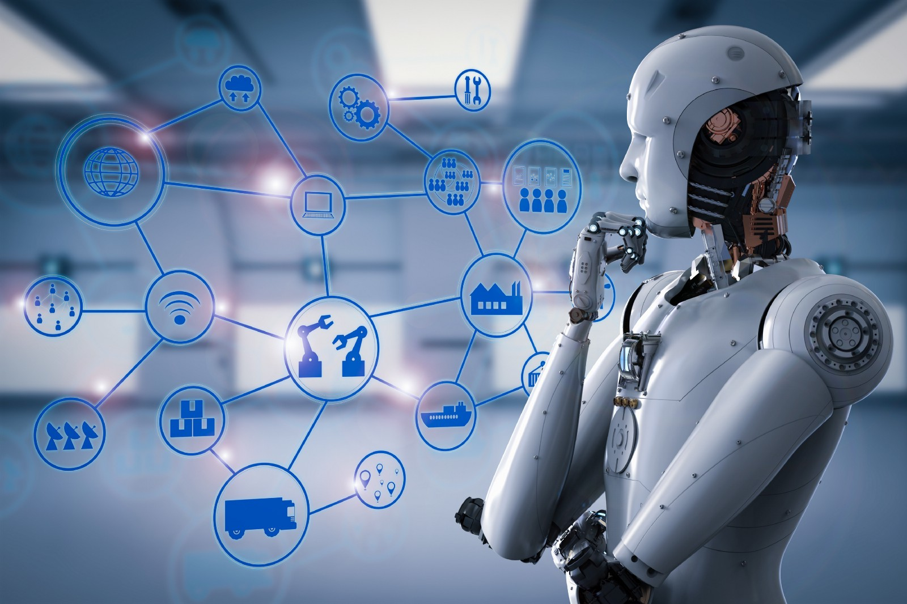
Speaker : Aashish

Slide 2
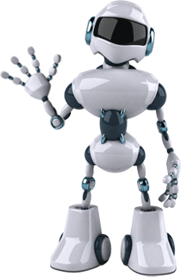
Agenda
1
What is Machine Learning?
2
Evolution & Future of Machine Learning
3
Biggest Confusion: AI vs ML vs DL
4
5
6
7
How does Machine Learning Work?
Types, Algorithms & Examples of ML
Use Cases of Machine Learning
Why the people are worried about AI?
8
Applications of Machine Learning
9
Open source library of Machine Learning
10
Google API to use Machine Learning models
11
Recommended way to get started
12
Which jobs will be replaced with AI?

Slide 3
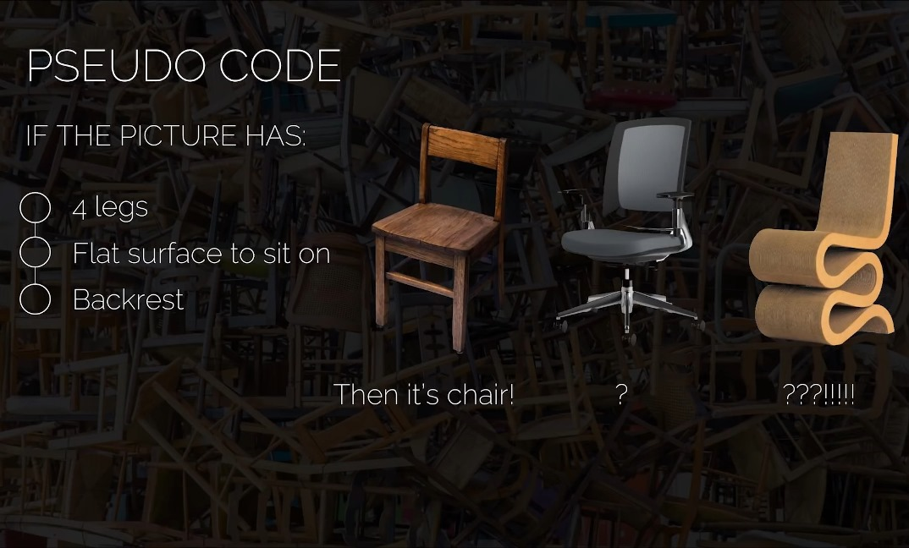

Slide 4
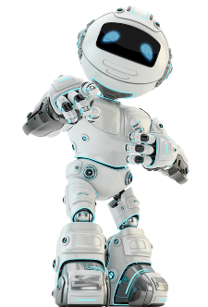
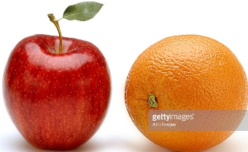
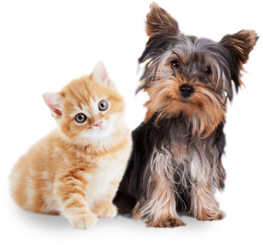
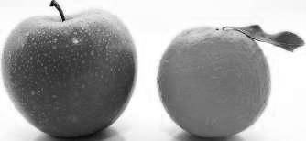
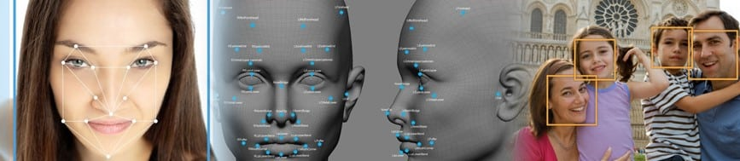
It is very hard to write programs that solve problems like:
Apple or Orange
Dog or Cat
recognizing a face, Then Machine Learning comes into picture

Slide 5
Rules
Programming
Answers
Data
Answers
Machine Learning
Rules
Data

Slide 6
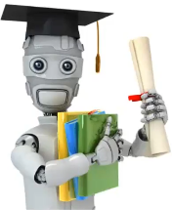
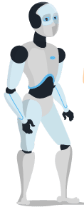
What is Machine Learning?
Machine learning is
learning from examples
and experience

Slide 7
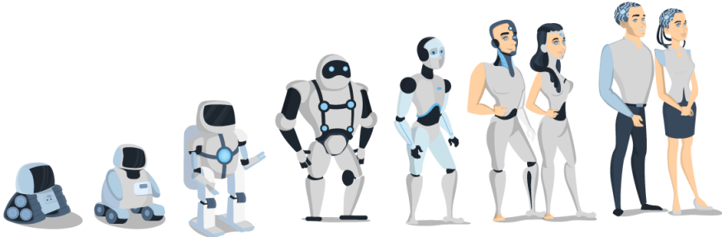
Evolution & Future of Machines
The era of machines and robots have just begun. You can consider it in a way that currently we are living in the primitive age of machines, while the future of machine is enormous(huge) and is beyond our scope of imagination.

Slide 8
Biggest Confusion: AI vs ML vs DL
Artificial Intelligence
Programs with the ability to
learn and response like humans
Machine Learning
Algorithms with the ability
to learn without being
Explicitly programmed
Deep Learning
Collection of neural networks & simple trainable mathematical units, organized in layers, that work together to solve complicated tasks

Slide 9
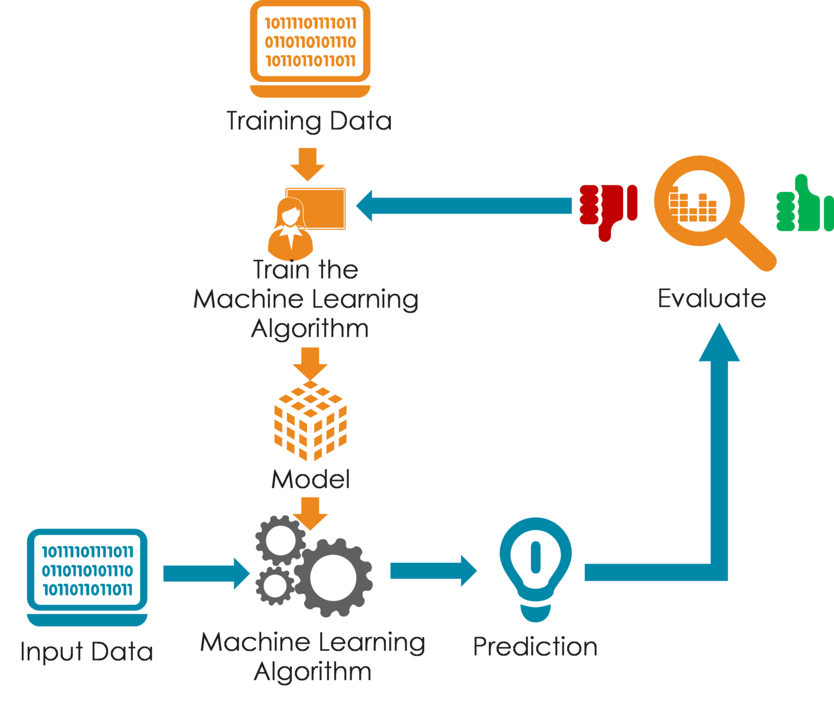
How does Machine Learning Work?

Slide 10
Types of Machine Learning
Supervised
Unsupervised
Reinforcement

Slide 11
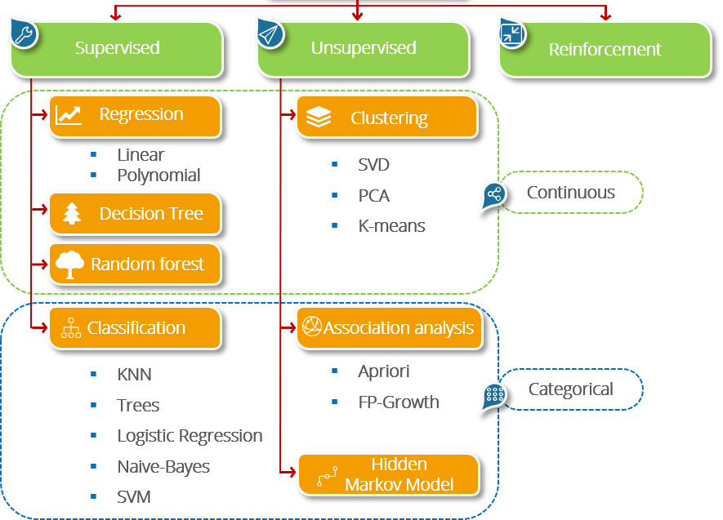
Algorithms of Machine Learning

Slide 12
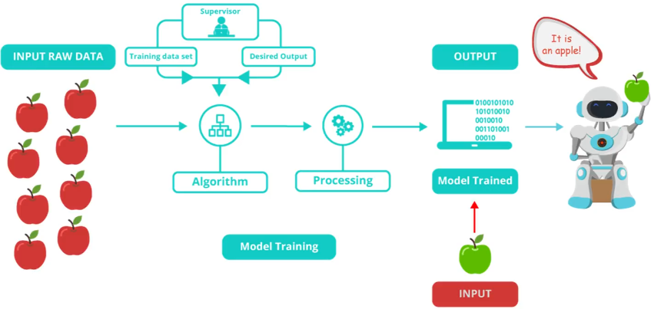
Supervised Learning
Train Me!
Labeled data
Direct feedback
Predict outcome/future

Slide 13
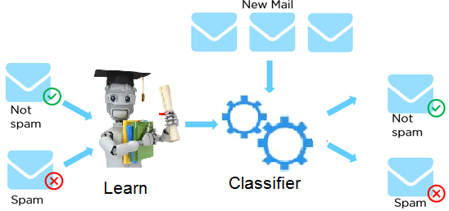
Example of Supervised Learning
An example of supervised learning using classification algorithms.
“How do email Spam Filters work? “
Dataset
Email | Label
Click here to claim your prize! | Spam
What’s new? | Not spam
Hang out later? | Not spam
You have won $1000,000 | Spam
… | …

Slide 14
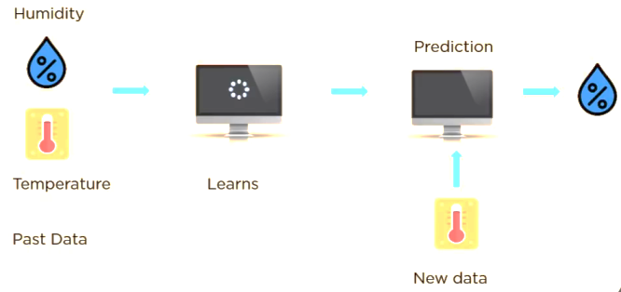
Example of Supervised Learning
An example of supervised learning using regression algorithms.
“Weather Prediction“
Dataset
Humidity | Temp.
Cloudy | 16
Sunny | 24
Rain | 10
Hot | 38
… | …

Slide 15
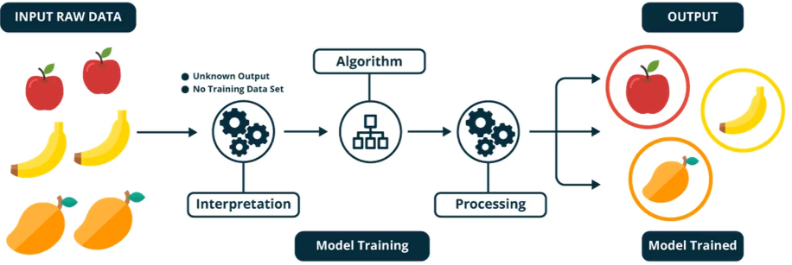
Unsupervised Learning
I am self sufficient in learning
No labels
No feedback
“Find hidden structure”

Slide 16
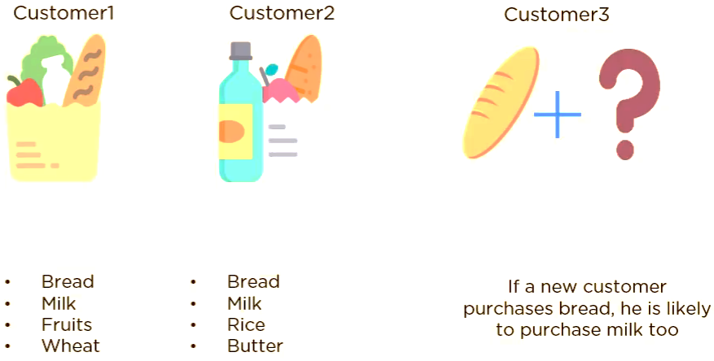
Example of Unsupervised Learning
Here is one example of unsupervised learning using association algorithm.
“Market basket or Recommendation system “

Slide 17
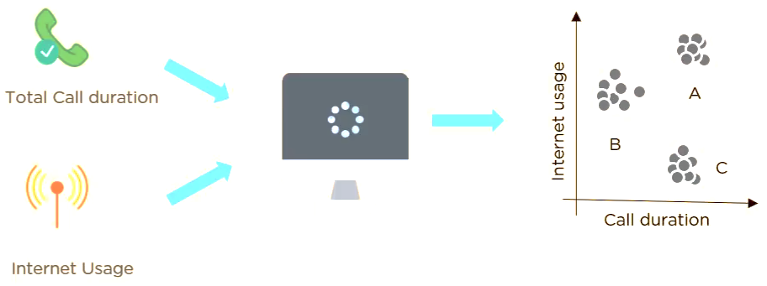
Example of Unsupervised Learning
Here is one example of unsupervised learning using clustering algorithm.
“Suppose a telecom company wants to reduce its customer churn rate by
providing personalized call and data plans“

Slide 18
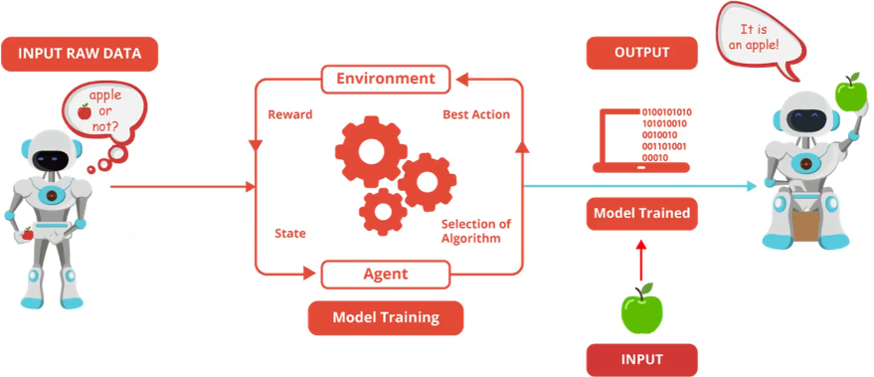
My life My rules! (Hit & Trial)
Decision process
Reward system
Learn from series of
actions/mistakes
Reinforcement Learning

Slide 19
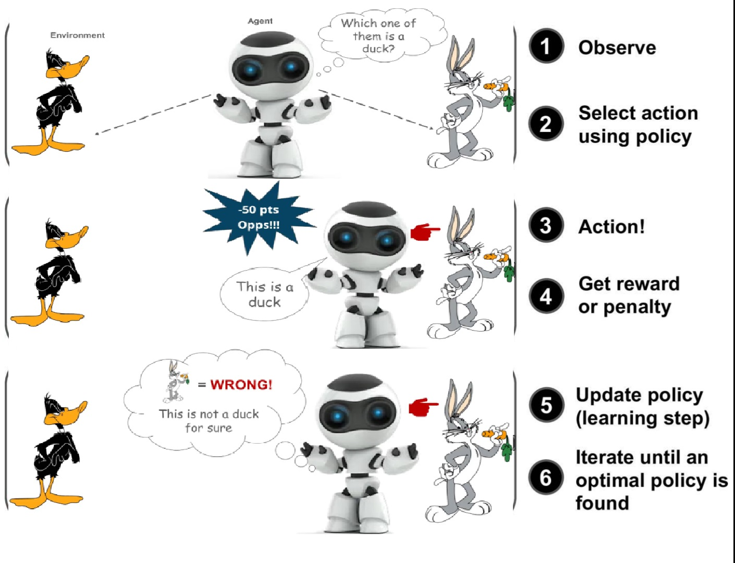
Example of Reinforcement Learning
Here is one example of reinforcement learning.

Slide 20
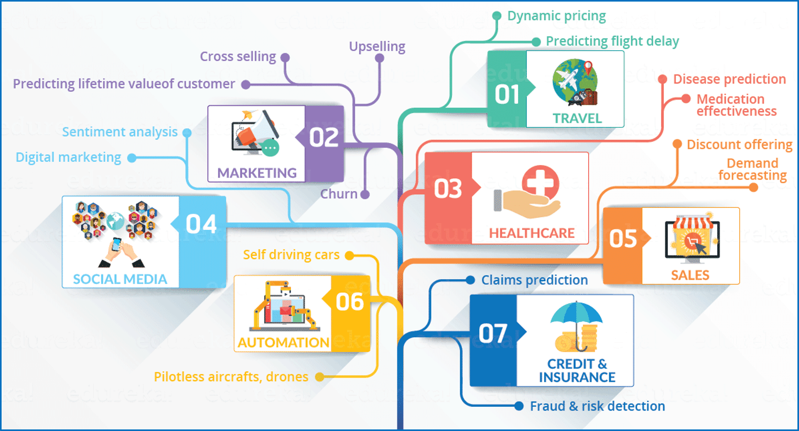
Use Cases of Machine Learning

Slide 21
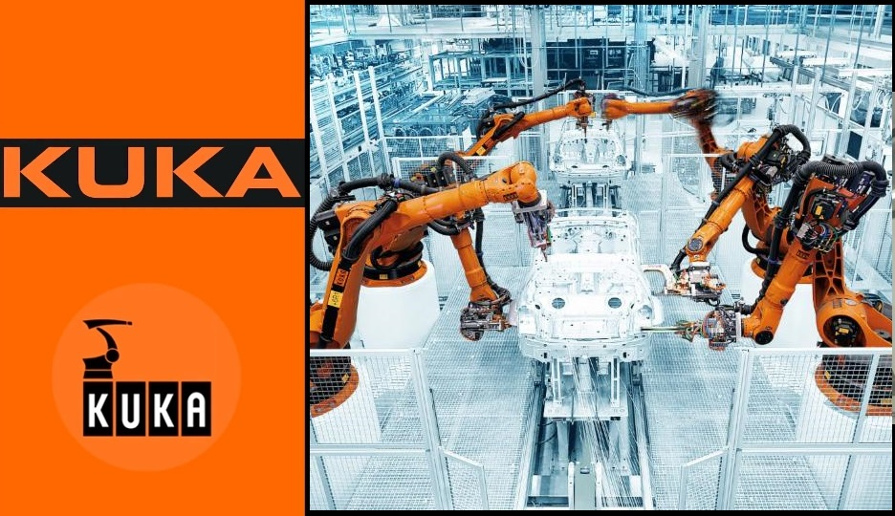
Applications of Machine Learning

Slide 22
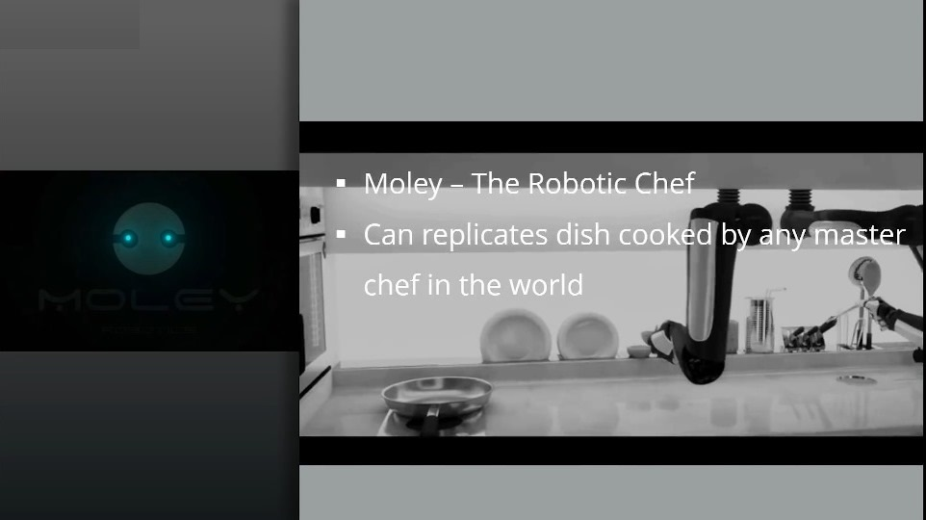

Slide 23
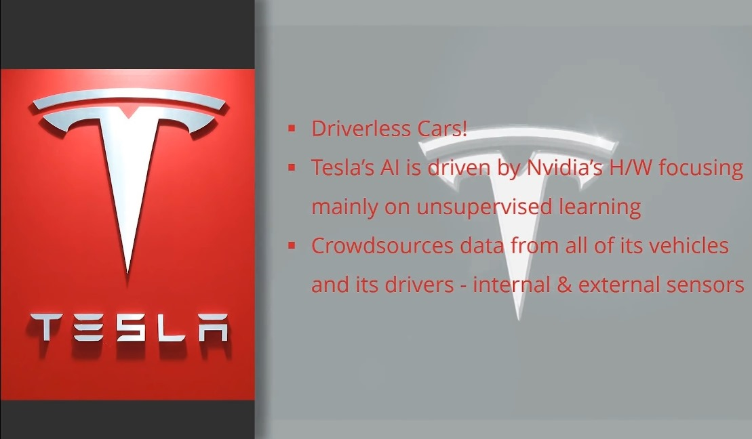

Slide 25
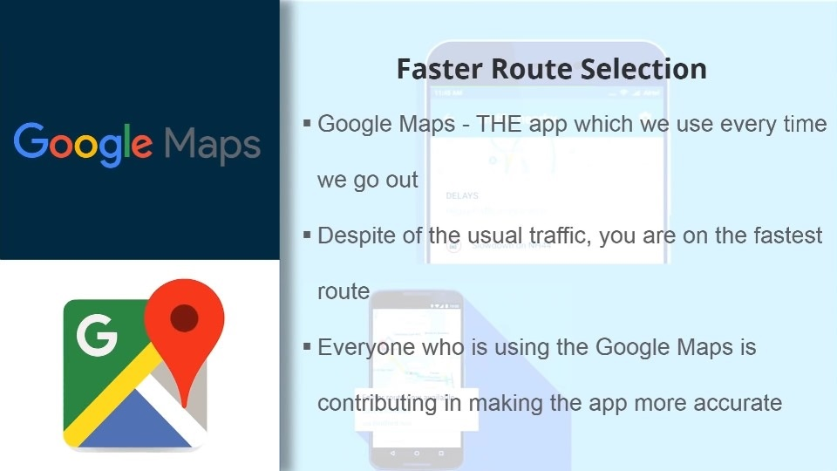

Slide 26
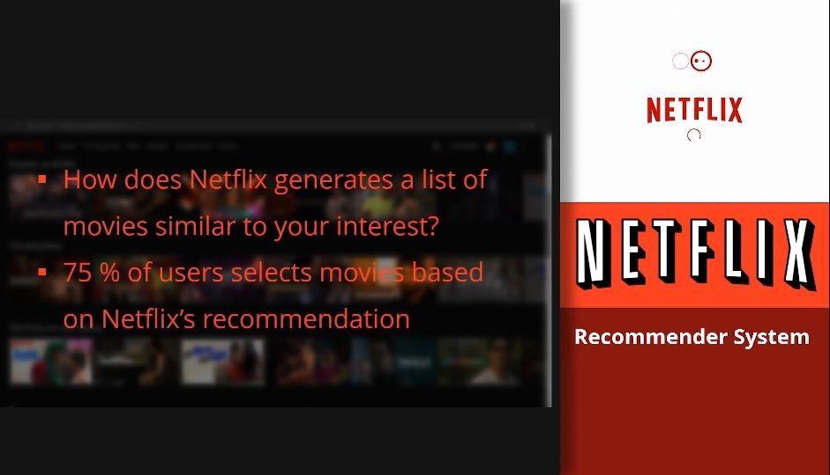

Slide 27
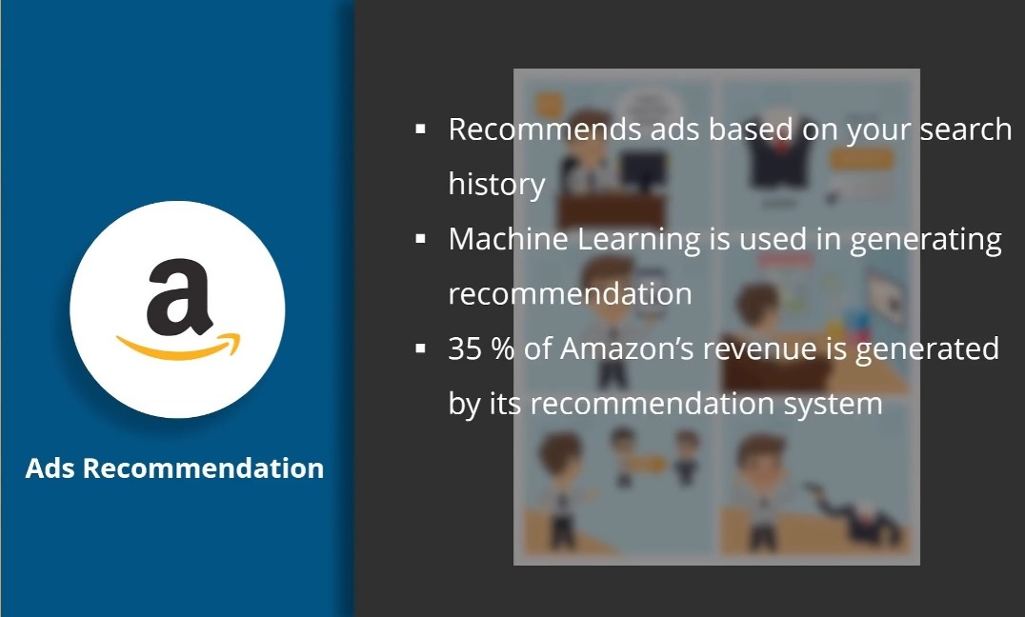

Slide 28
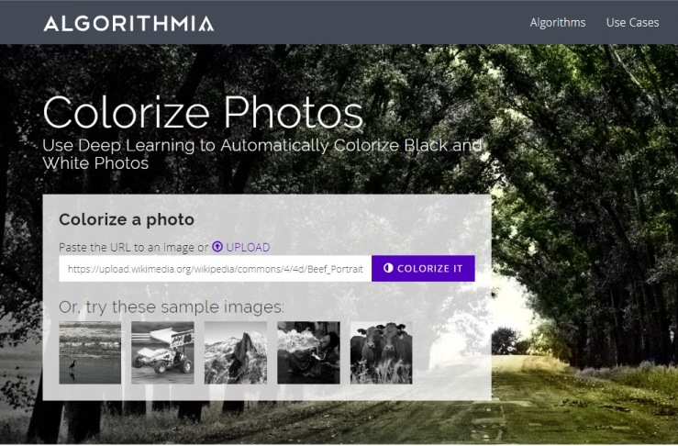

Slide 29
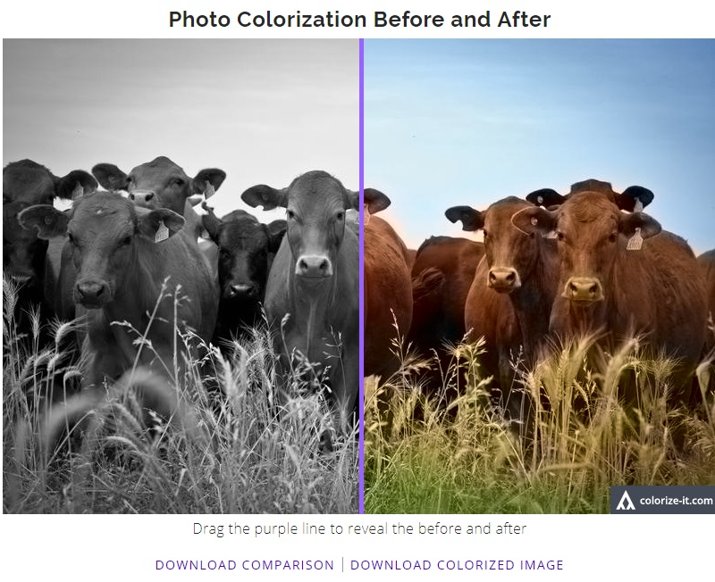

Slide 30
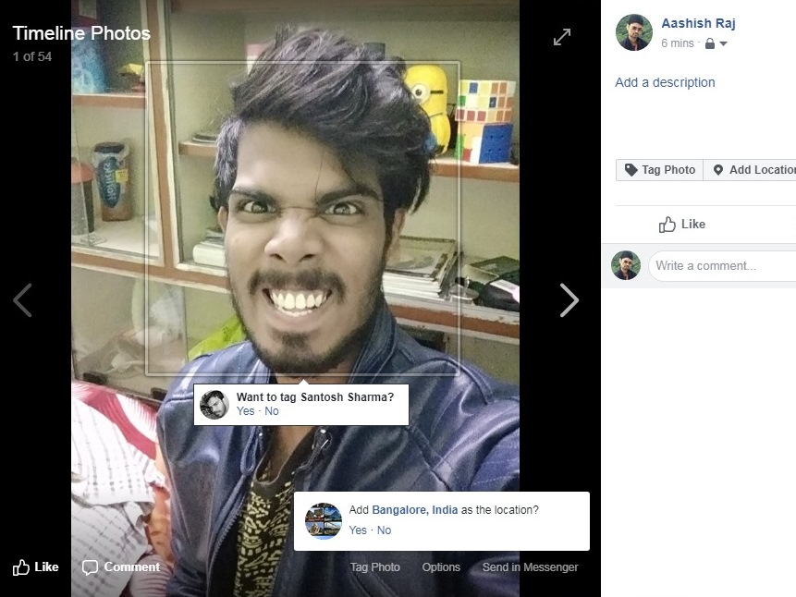

Slide 31
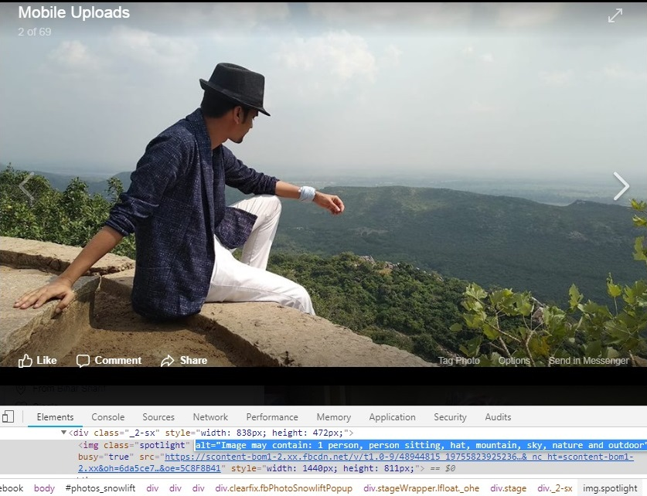

Slide 33
Examples of CRM with AI & ML
It’s no surprise that some of the biggest names in CRM are eagerly touting their new artificial intelligence expertise. Companies like Salesforce, SugarCRM, Zoho and MicroSoft have all integrated some form of AI into their platforms over the last few years.

Slide 34
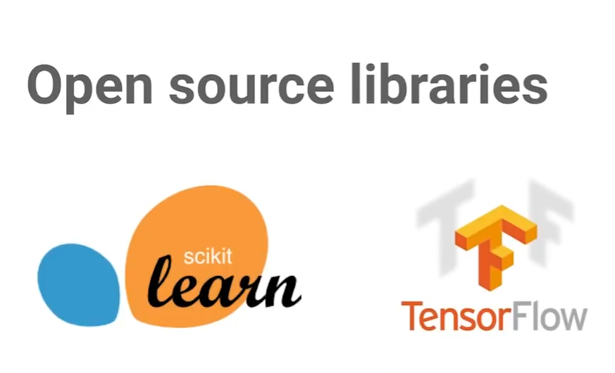

Slide 35
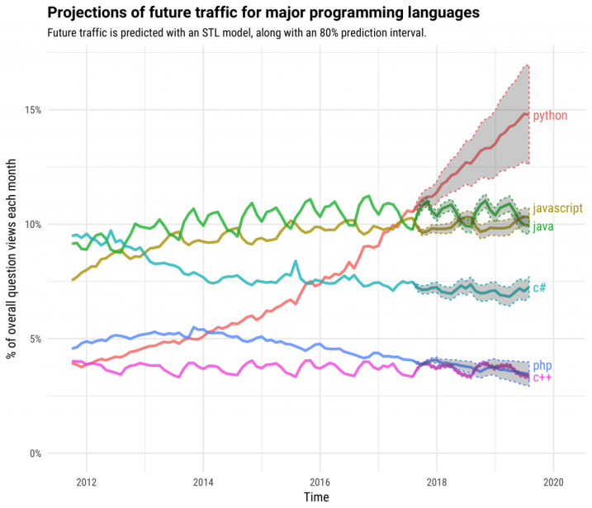

Slide 36
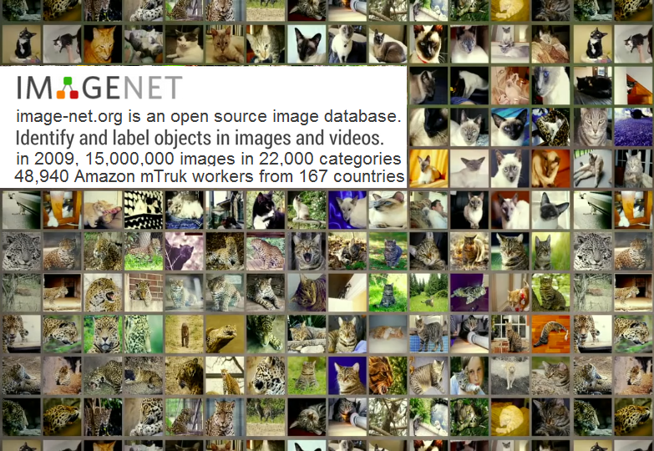

Slide 37
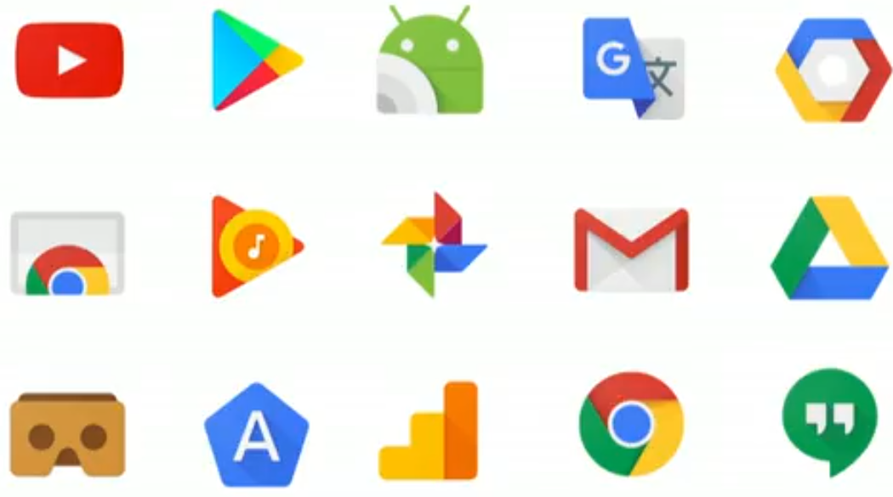
Google using TensorFlow in their apps

Slide 38
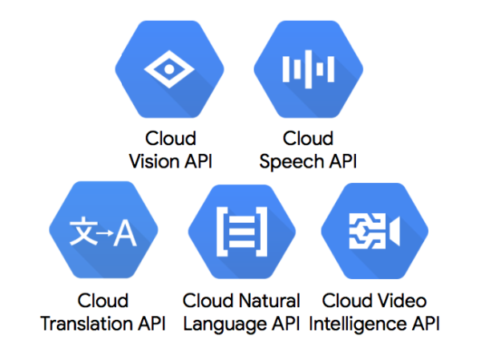
Google API to use Machine Learning models

Slide 39
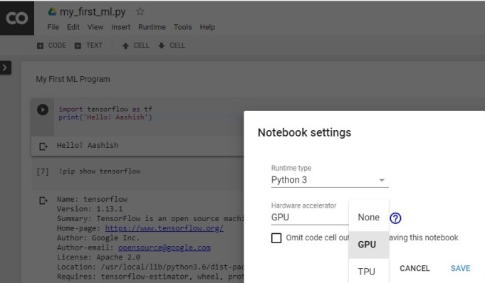
Recommended way to get started
Tutorials and code
Deep Learning with TensorFlow
tensorflow.org
Udacity class goo.gl/iHssII
Standford’s CS231n
Machine Learning Crash Course
cs231n.github.io
g.co/machinelearningcrashcourse
Google Colab
Code is online: github/tensorflow/workshops

Slide 40
Which jobs will be replaced by AI?
Optimization
Creativity or Strategy
Repetitive
Tele-sales
Dishwasher
Customer Support
Routine
Hematologist
Security Guards
Car/Truck driver
Optimizing
Reporter
Radiologist
Research Analyst
Complex
CEO
Economist
ML & AI Expert
Creative
Artist
Scientist
Columnist
Optimization
Creativity or Strategy
Repetitive
Routine
Optimizing
Complex
CEO
Economist
ML & AI Expert
Creative
Artist
Scientist
Columnist
AI
AI
AI
5 Years
10 Years
15 Years
SAFE
SAFE

Slide 41
Why the people are worried about AI?

Slide 42
Conclusion
AI is the new electricity… Just as 100 years ago electricity transformed industry after industry, AI will now do the same.
Artificial intelligence (AI) and machine learning (ML) are coming of age, We are changing that to accelerate the industrialization of enterprise ML and AI.
Moreover, We have to ready with ML control system in advanced, so that the machine era will go up.

Slide 43
Reference Material
https://cloud.google.com/products/ai/
https://www.edureka.co/blog/what-is-machine-learning/
https://dzone.com/articles/future-of-machine-learning-why-learn-machine-learn
https://skymind.ai/wiki/machine-learning-algorithms/
https://www.crmswitch.com/crm-features/crm-artificial-intelligence/
https://demos.algorithmia.com/colorize-photos/
https://www.independent.co.uk/life-style/gadgets-and-tech/news/elon-musk-artificial-intelligence-openai-neuralink-ai-warning-a8074821.html
https://www.theguardian.com/technology/2016/jun/12/nick-bostrom-artificial-intelligence-machine
https://environmentaljusticetv.wordpress.com/2014/12/02/bbc-news-stephen-hawking-warns-artificial-intelligence-could-end-mankind/
https://steemit.com/steemit/@davidyakobovitch/where-is-data-science-trending-in-2018
https:// playground.tensorflow.org/
https://cloud.google.com/vision/
https://cloud.google.com/speech-to-text/
https://cloud.google.com/translate/
https://cloud.google.com/natural-language/
https://cloud.google.com/video-intelligence/
https://blogs.microsoft.com/blog/2018/09/18/announcing-new-ai-and-mixed-reality-business-applications-for-microsoft-dynamics/
eg: Denisys Technology, Joseph Mathew Exposed, What's new in Maple CRM at Seminar in Bangalore.

Slide 44




Aashish Kumar
Maple CRM Developer
aashishraj97@gmail.com
@aashishraj97
Slides, Videos & Code :
goo.gl/jrd7AR

